Slide 1


L1: Statistics
Digital Health
UCSD Extension – Specialization Certificate
Data Science for Healthcare
Hobson Lane, UC San Diego
Instructor

Slide 2
Syllabus
Week | Title | Topics | Exercise
1 | Data Science in Healthcare | applications, terminology, HIPPA | anonymize dataset PII
2 | Spreadsheet Data Science | ETL, exploration & visualization | height, weight, BMI, gender
3 | Statistics | causality, correlation, MLE | causal diagram “games”
4 | Clinical Data Science | PII, prescriptive vs descriptive | predict diabetes risk
5 | Hospital Performance Modeling | time series, unintended conseq. | Mid-term Quiz!
6 | Population Health (Epidemiology) | GIS, spatio-temporal modeling | visualize/analyze Ebola
7 | Scoping Review & Gap Analyses | diabetes, military women | review smoking research
8 | Natural Language Processing | IA, summarization, text mining | find summary with spaCy
9 | Occ. Health & Assistive Tech. | Tesla & Aira case studies, OSHA | analyze medicine OCR app.
10 | Policy, Privacy and Ethics | bias, fairness, anonymization | Final Exam!
Proj. | Train your own healthcare model | find/download data, ETL, | fit/train a DS model

Slide 3
What is NLP?
How is NLP used in healthcare?

Slide 4
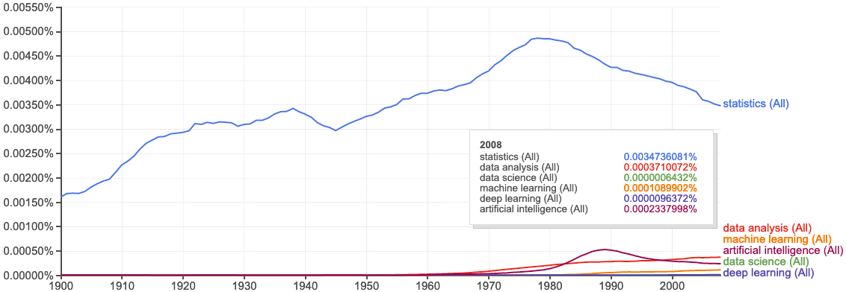
Terminology Progression
books.google.com/ngrams

Slide 5
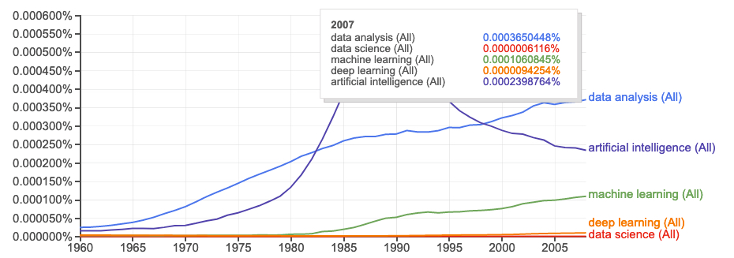
Data Science on “data science”
Peter Naur
“datalogy”
“data science”
books.google.com/ngrams

Slide 6
Bayesean Filter (Spam Filter)
Updated Probability = Likelihood Ratio x Prior Probability

Slide 7
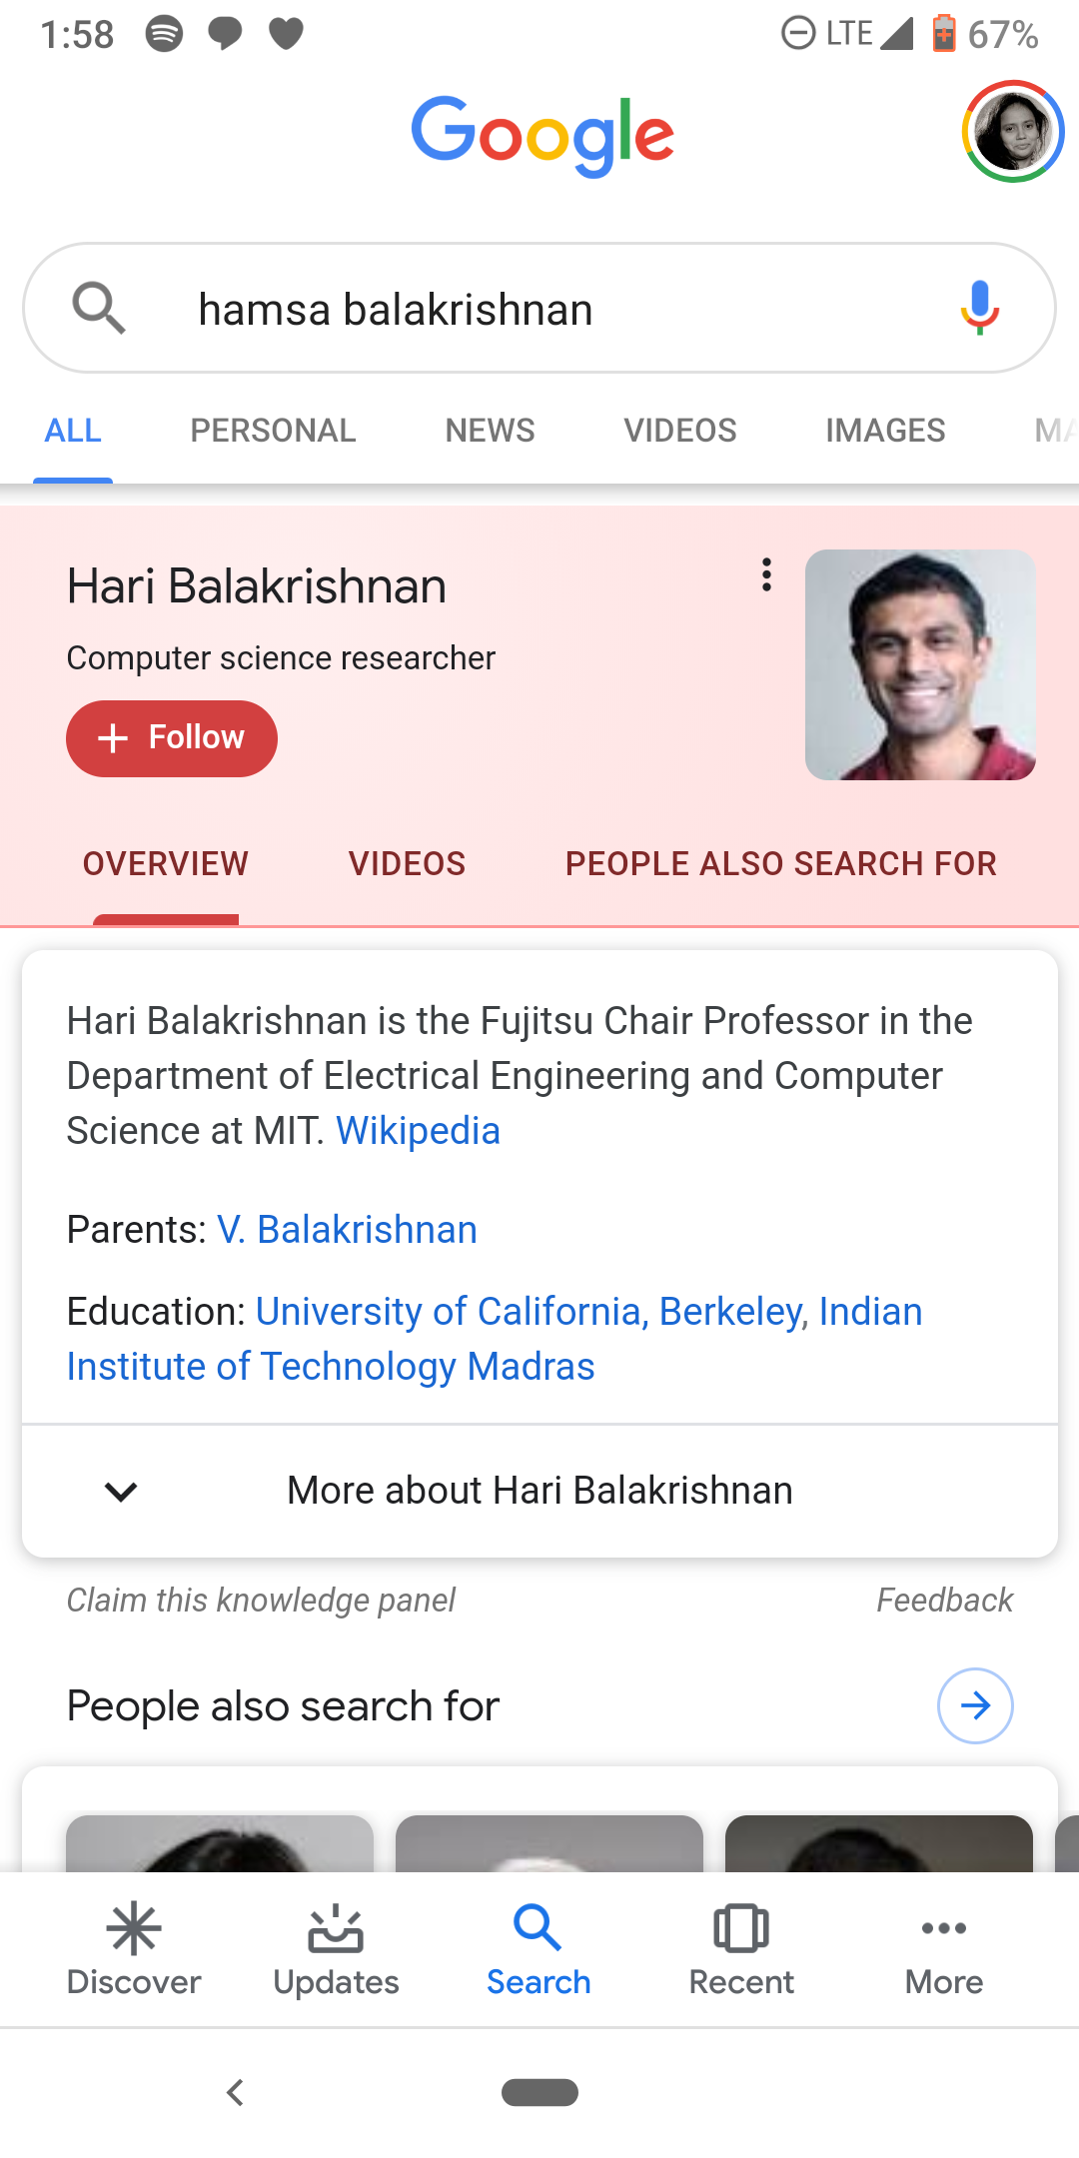
Gender Bias
Hamsa is a female CS researcher
Hari is her brother
Their parents are both famous

Slide 8
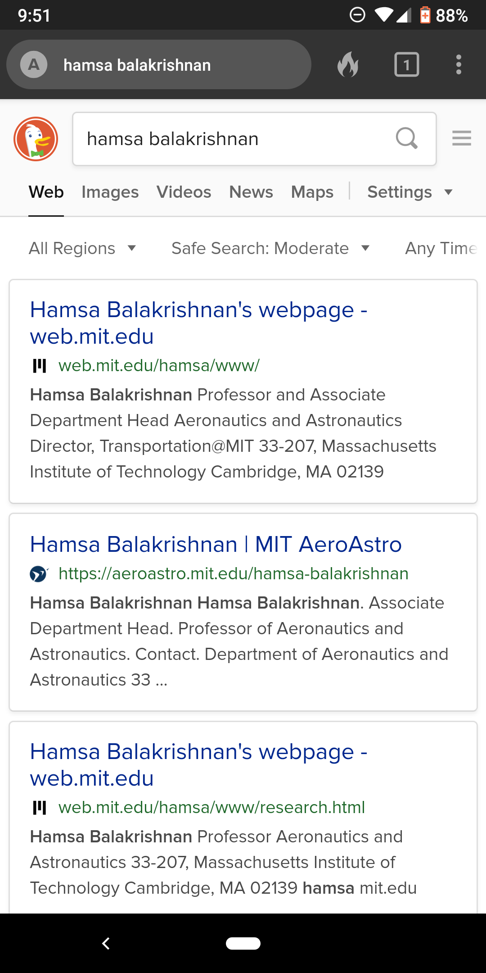
Duck the Bias!

Slide 9
Assignments

Slide 10
Quiz
How much femaleness is in the word “nurse”? “doctor”?

Slide 11
Homework: Create diabetes MLE

